Slide 1

ORPHAN SHELTER MANAGEMENT (OSM)
Under the guidance of
Ms. Senu Abi
Main Project:
Sandra Davis
Master Of Computer Application

Slide 2
01
Introduction
02
Objective of the System
03
Existing System and Proposed System
Contents
CONTENTS
04
Modules
05
Software requirement

Slide 3
01
Introduction
Contents

Slide 4
Introduction
Orphan Shelter Management is android application which is helpful for Service people as well as the admin authorities. In the current system all the activities are done manually. It is very time consuming and costly. Our Orphan shelter Management deals with the various activities related to the orphanage. In the proposed system we develop two android applications. One for storing details and private data . The second app contain three modules. Orphanage , Adopter’s and Donator’s
In adoption category they will get list of orphans and their details of different orphanages. In the case of sponsor it include various types of sponsorship.
This system will hep to find the orphanages and their needs. The system will give online transaction , so it will be a help to the donators and sponsors.
It has three users one is donation /adoption and sponsors. In the donation category they can donate food, clothes and money the particular orphanage they wish.

Slide 5
02
Objective of the System
Contents

Slide 6
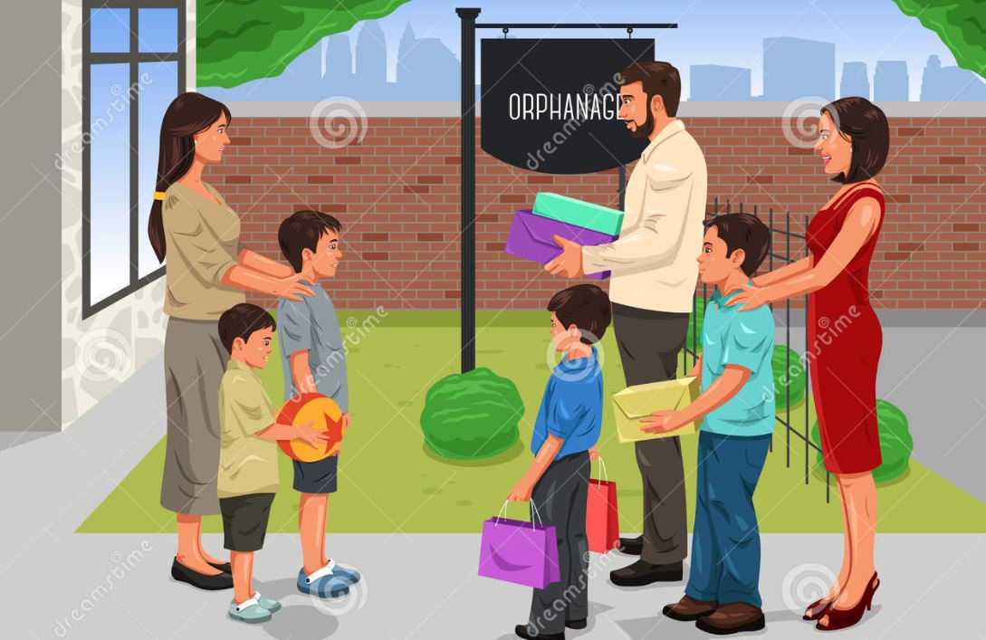
Objective
The application’s Orphan shelter Management is developed to help to reach the needy orphanages by the volunteering donations. The objective of the project is to develop an application for the orphanage to analyze current requirement and to schedule the donators. And in the case of a donator is to analyze current requirement of orphanages and to provide donation so the apt orphanage. A donator can view the list of item put up by orphanages and can donate the same is possible. The another purpose of the project is to keep records of orphans in the orphanage home , accounts, activities and other all details of orphanages. This proposed system will change the conventional manual management to a digitalized system. This will facilitates information acquisition, storage and retrieval.

Slide 7
03
Existing System and Proposed System
Contents

Slide 8
Existing System
In the old process of adoption & donation donor have undergo many manual process . Prospective adoptive parents need to register with an authorized agency , Home study and the child, Filling of the petition , Acceptance of the child , Pre adoption foster care , Referral of the child , Court hearing , Court order ,Follow up
Disadvantages
• Adopter is limited
• It increases the delay of adoption and time consuming.
• There is no option for donating through online

Slide 9
Proposed System
In the proposed we are going to develop android applications. The application is used to store the details and private data’s of the orphanage and it is developed to help the donator’s , adopter’s and sponsor’s to find the needy orphanages by volunteering donations , help the adopters to find the orphanage for adoption and help the sponsor’s to get the details of the child.
Advantages
• Easy to finding the orphanages.
• Easy to resolve the problem with in the span of time to given donation to the needy people.

Slide 10
04
Modules
Contents

Slide 11
Modules
ORPHANAGE
In this module they can manage their profile after registration approval, that is their private data like details of children , staff and other activities . They can view the all details of sponsors , donators and adaptors. In donation they can update their needs .
ADMIN
In the admin module they can approve orphanage registration and can manage all orphanages. They can view their private data . The admin can view the details of users and they can manage the users
USER
After sign in users can choose three type of services. In donation they can view the needs of the orphanage and donate what they need. Also there is a payment option. In the case of adoption they can view the list of orphanages and they can submit the necessary documents. In sponsorship it include many type of sponsorships. Sponsors can view the orphanages and they can communicate with the orphanages and with the permission of orphanages they can view the details of children.

Slide 12
05
Software requirement
Contents

Slide 13
Software requirement
Front end
ANDROID
All user interface elements in an Android app are built using View and View Group objects. A View is an object that draws something on the screen that the user can interact with.
A View Group is an object that holds other View (and View Group) objects in order to define the layout of the interface. Android provides a collection of both View and View Group subclasses that offer you common input controls (such as buttons and text fields) and various layout models (such as a linear or relative layout)

Slide 14
User interface design and Back-end design
BACK END
Python
Python is a general-purpose interpreted, interactive, object-oriented, and high-level programming language. It was created by Guido van Rossum during 1985- 1990. Like Perl, Python source code is also available under the GNU General Public License (GPL). Python is a high-level, interpreted, interactive and object-oriented scripting language. Python is designed to be highly readable. It uses English keywords frequently where as other languages use punctuation, and it has fewer syntactical constructions than other languages.

Slide 15
ORPHAN SHELTER MANAGEMENT (OSM)
THANK YOU

